Slide 1
Goods to Person Technologies – Which Is Best For You?
Reliability and Value Engineering Analysis

Slide 2
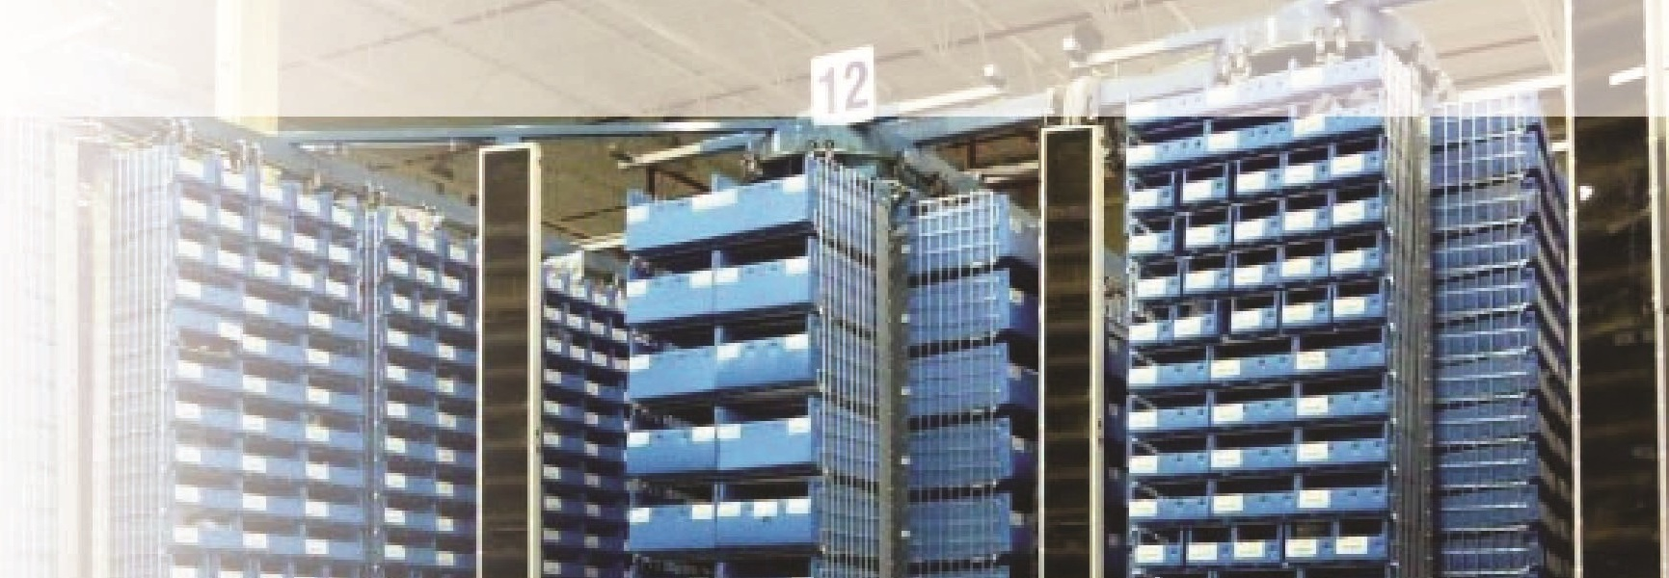
ABOUT US
30 years in small item, goods to person automation space.
1991 – began in “technology Transfer”
1994 – Magic Warehouse™ software
Technology support – Parts/Service
2018 Pallet G2P

Slide 3
Solutions
2000-10,000 Pick Locations
Traditional
Small Item Shuttles (Opex)
Order Pickers
Mini-Stacker
AS/R Horizontal Carousels
Vertical Carousels

Slide 4
Solutions
More Efficient
• Opex
• Horizontal
Carousels
More Expensive
Less Expensive
• Vertical Carousels
• Stacker Crane
• Order
Pickers
Less Efficient
• Traditional
Storage

Slide 5
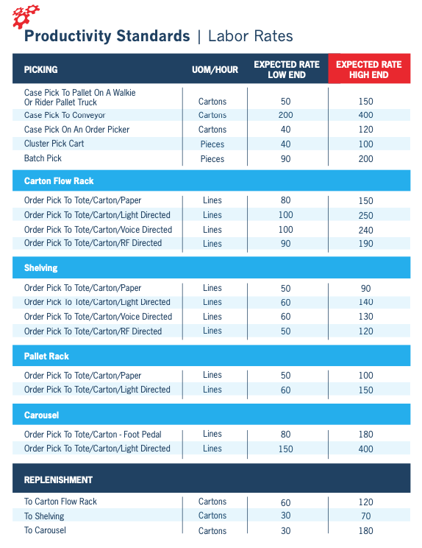
Productivity Standards

Slide 6
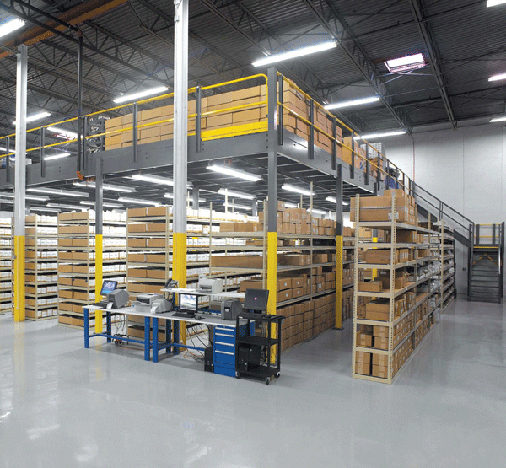
Traditional Storage
Low Cost
Low Speed
Low Density

Slide 7
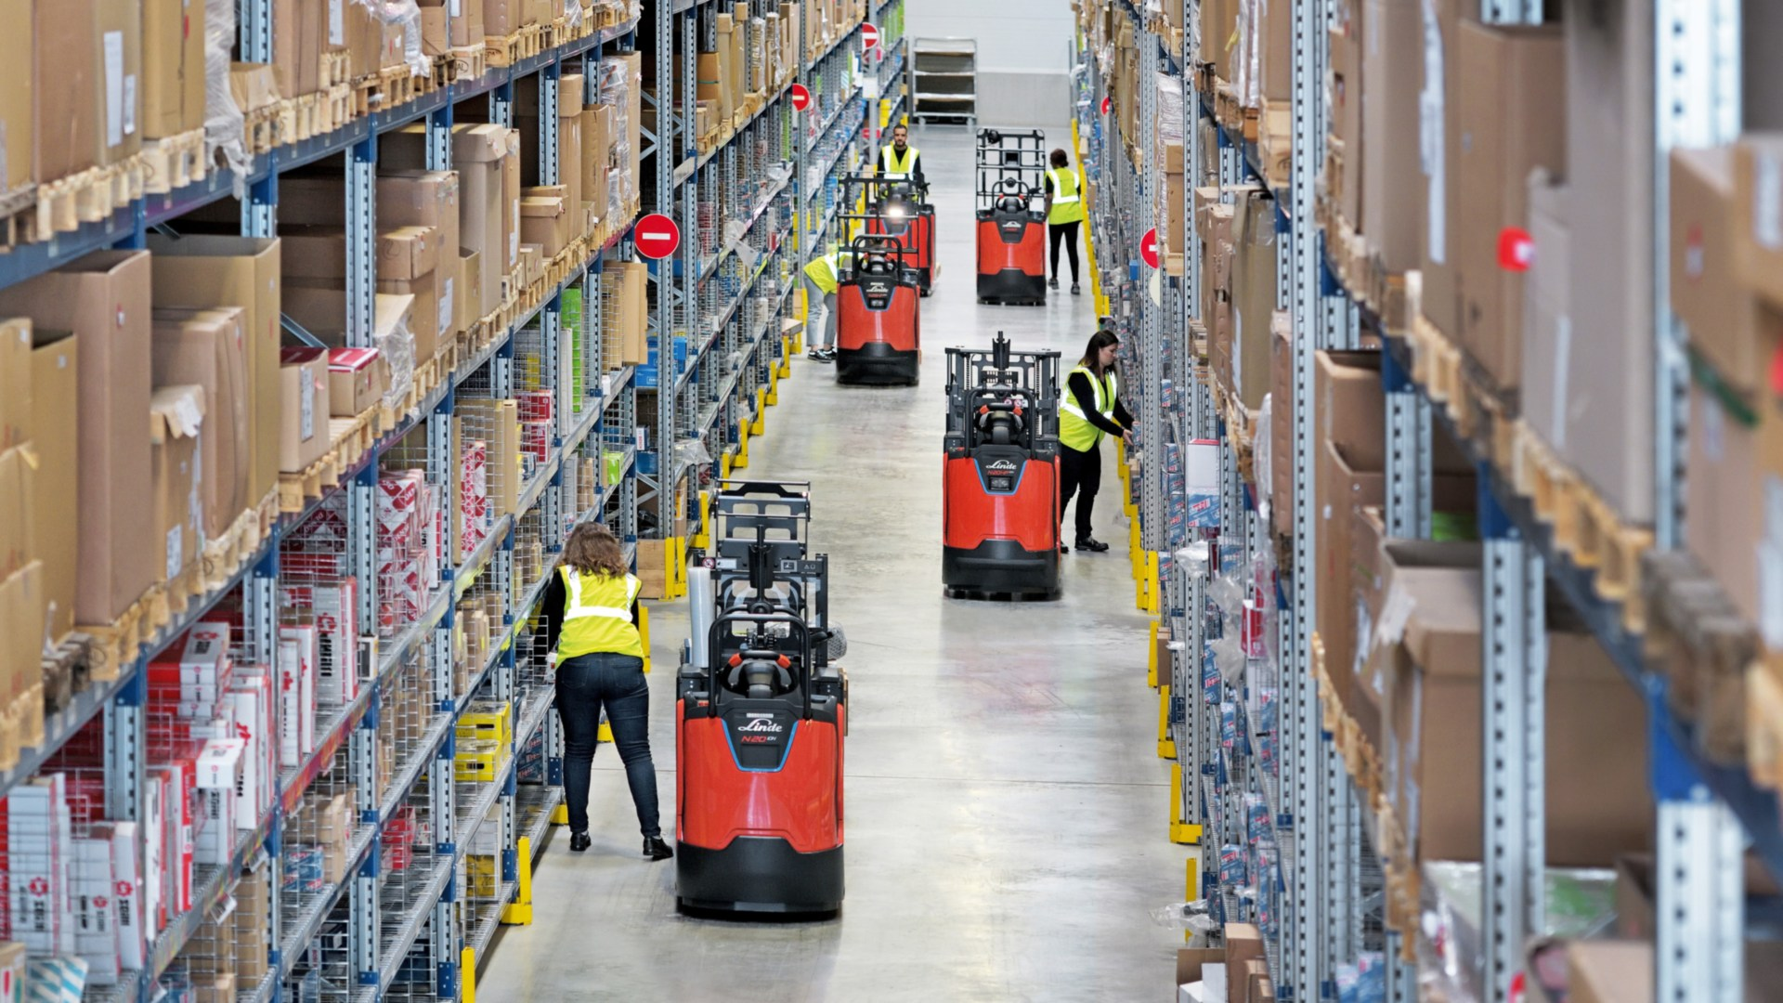
Order Pickers
Low to Medium Cost
Slow Speed
Low Density

Slide 8
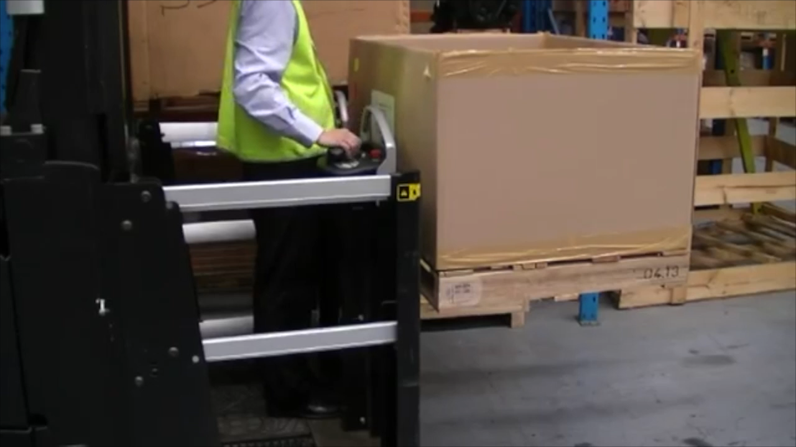
Order Pickers
Low to Medium Cost
Low Speed
Low Density

Slide 9
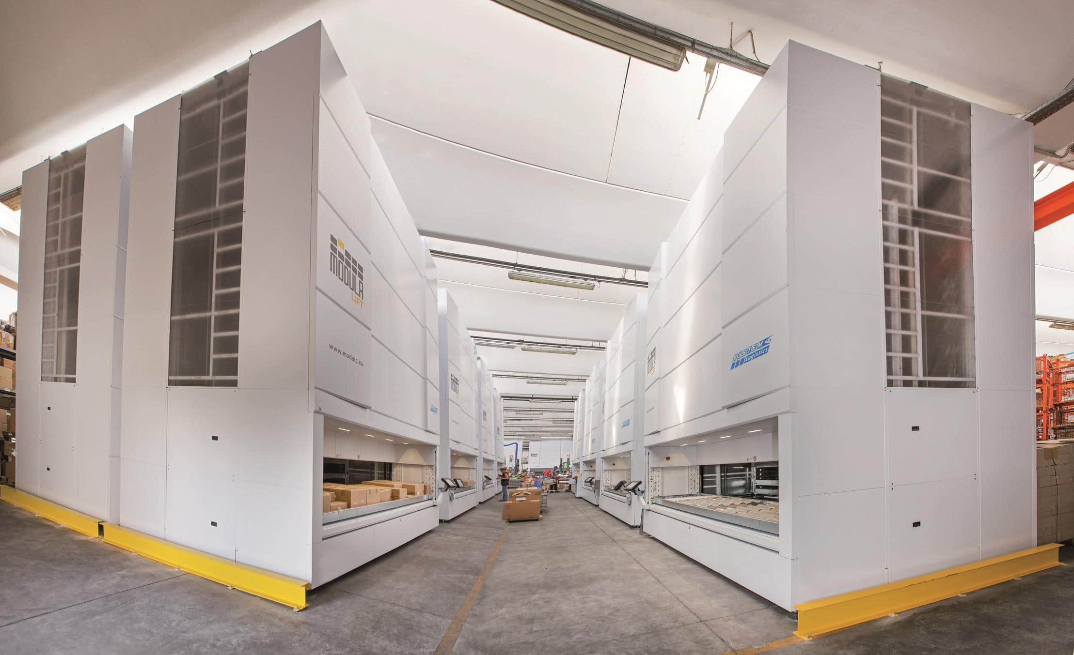
Vertical Carousel
High Cost
Low Speed
Medium Density

Slide 10
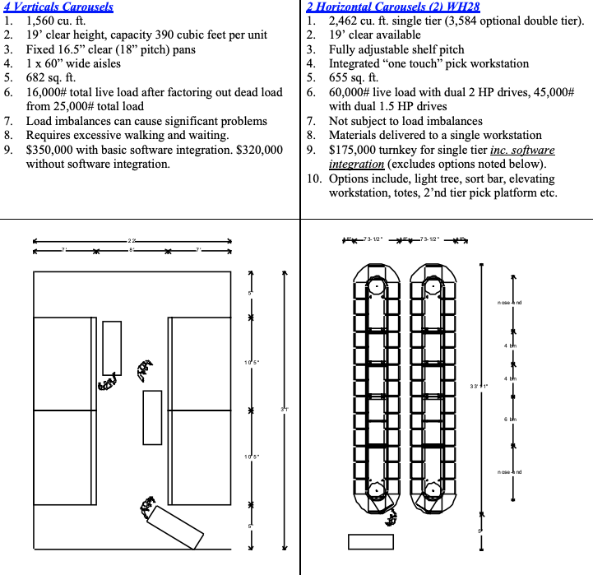
Vertical Carousel
High Cost
Low Speed
Medium Density

Slide 11
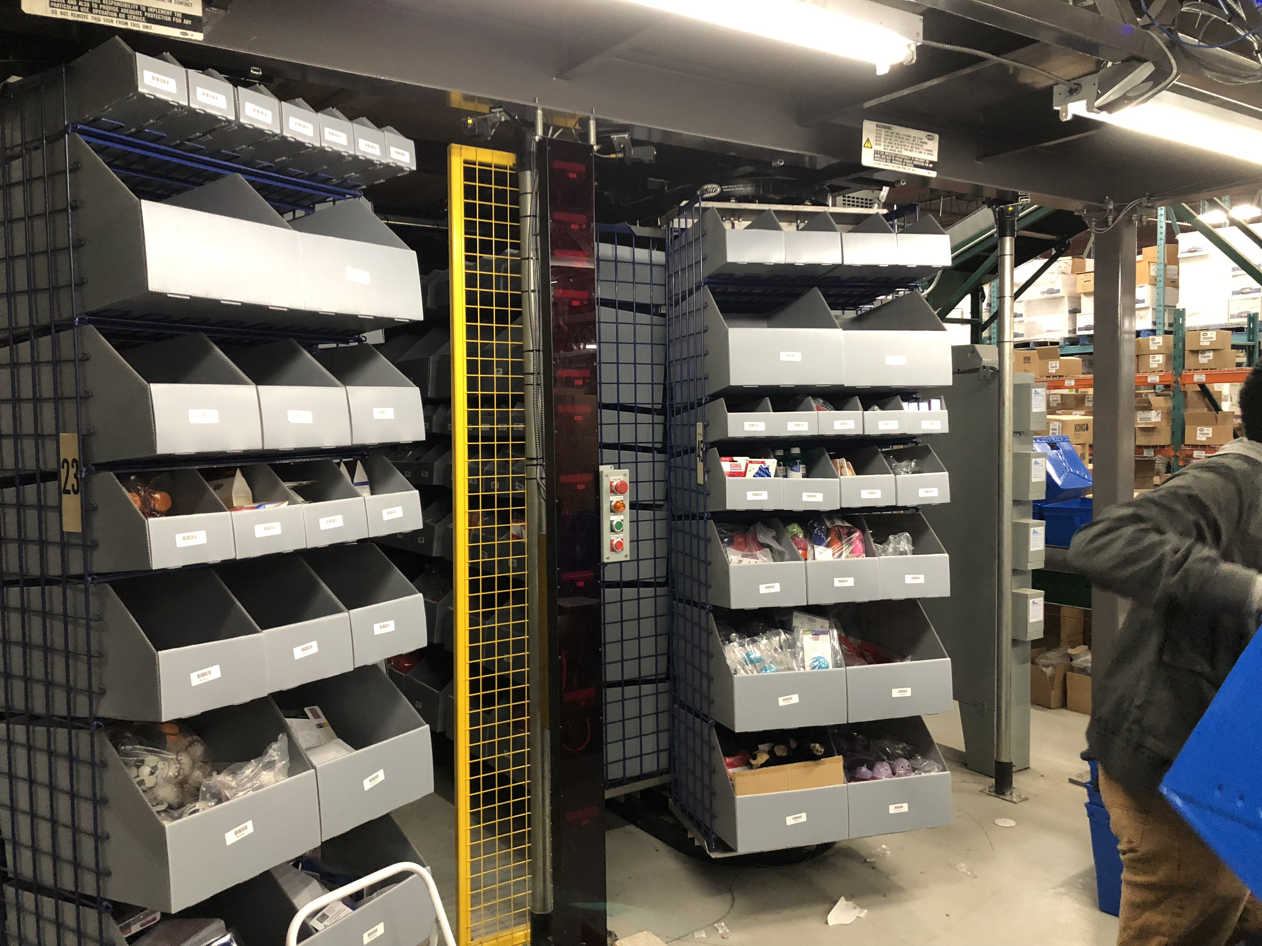
AS/R Horizontal Carousel
Medium Cost
High Speed
High Density

Slide 12
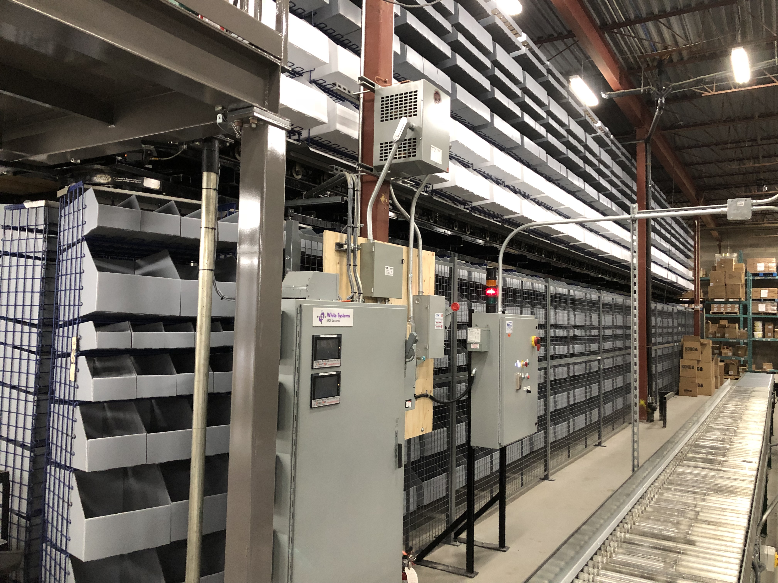
AS/R Horizontal Carousel
Medium Cost
High Speed
High Density

Slide 13
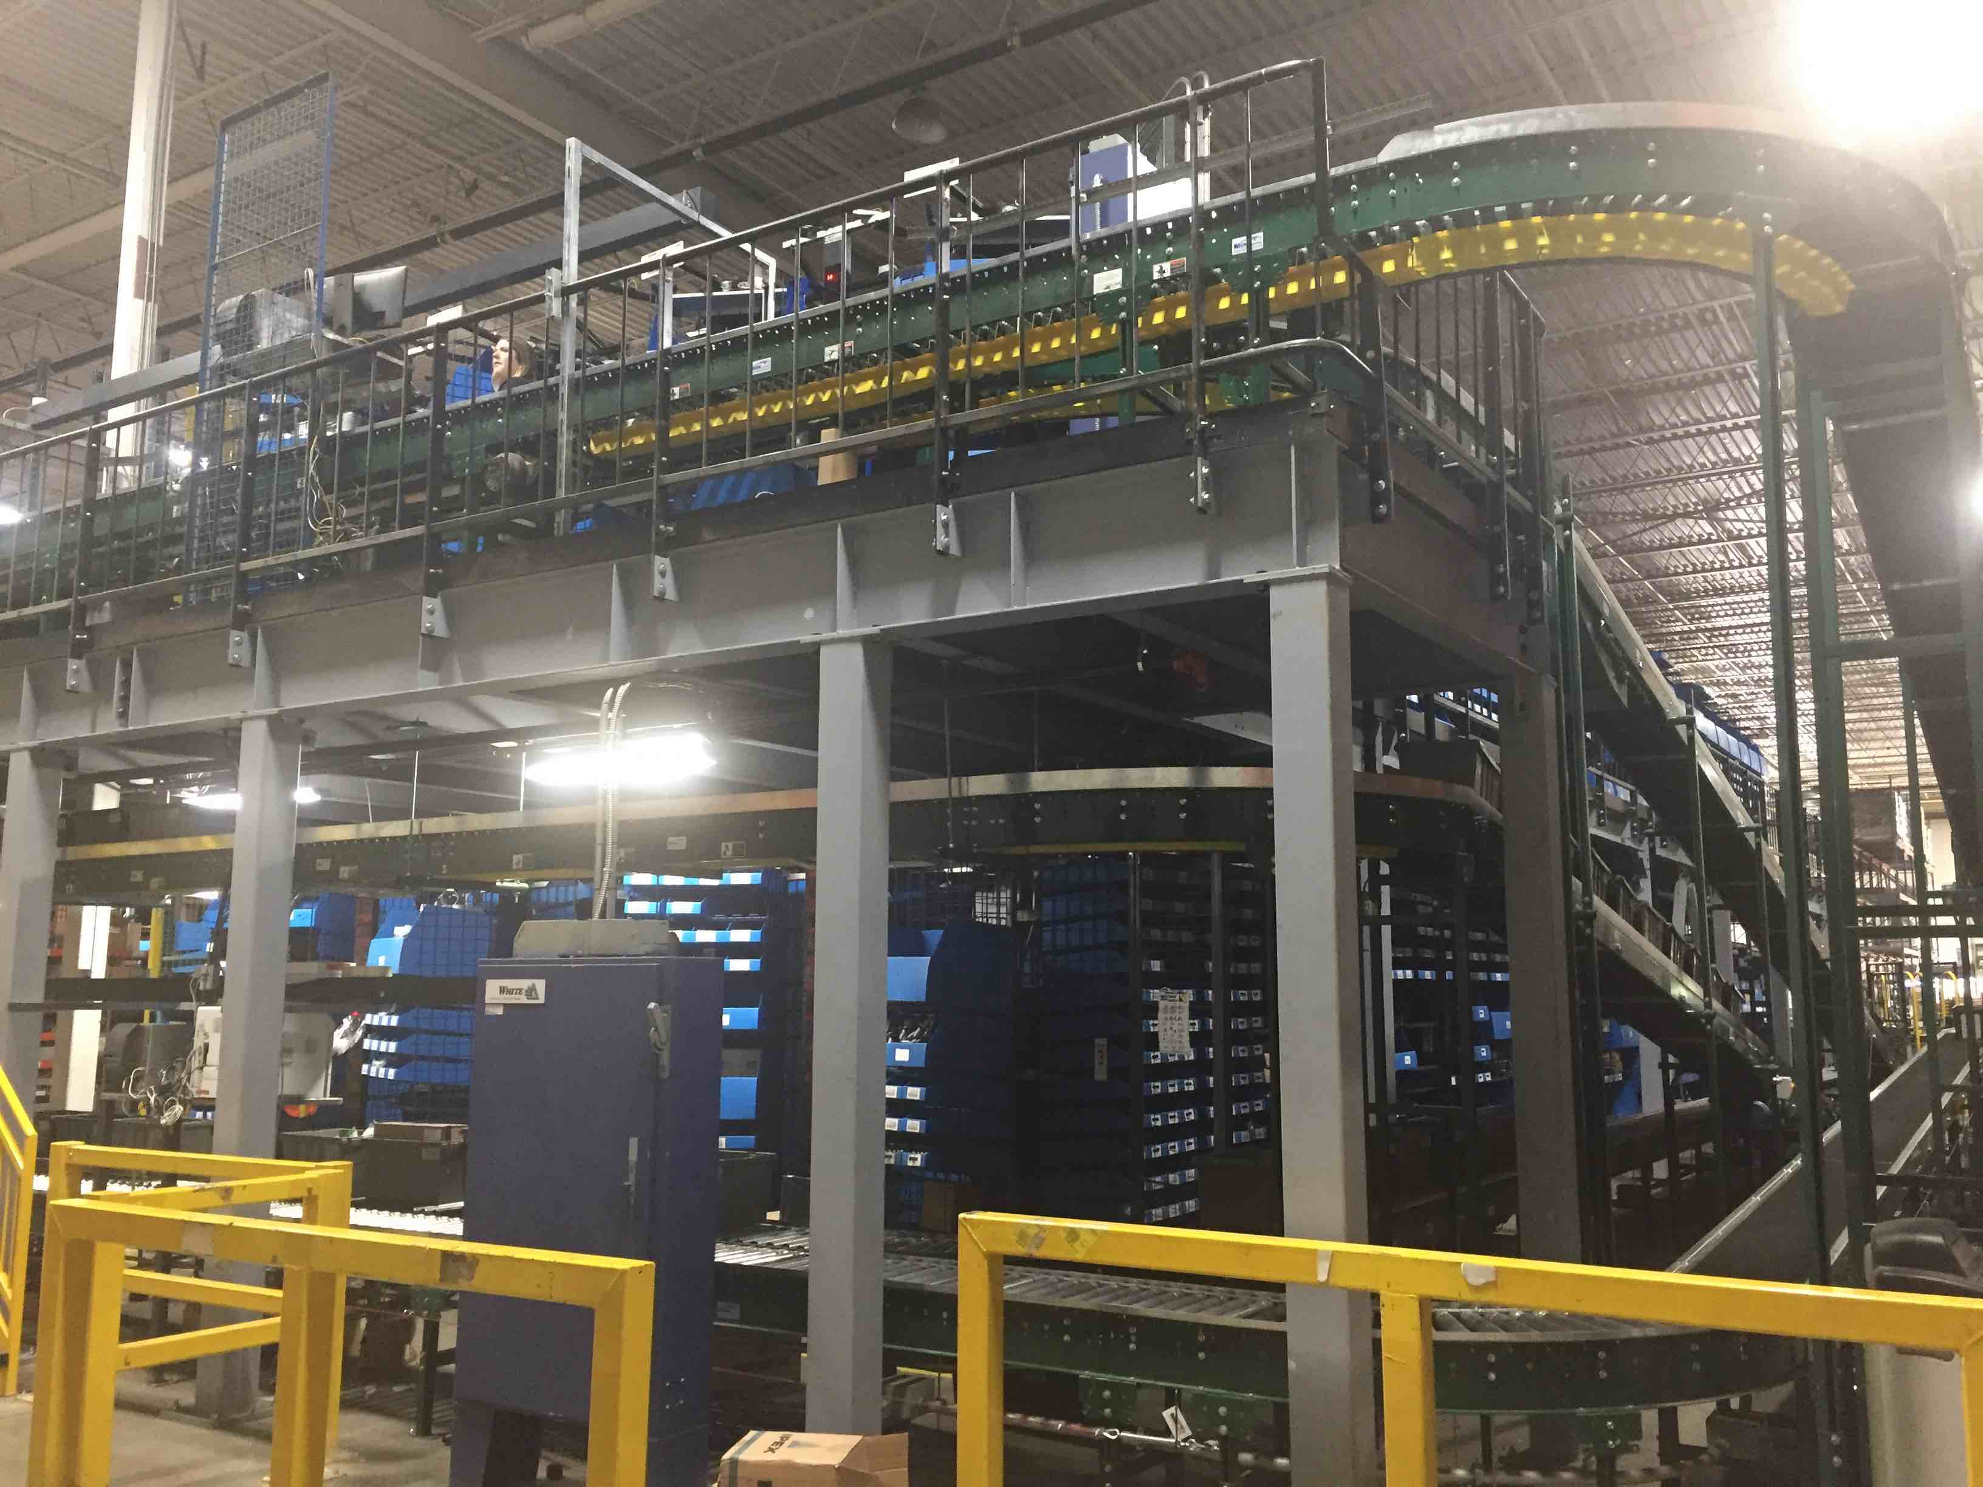
AS/R Horizontal Carousel
Medium Cost
High Speed
High Density

Slide 14
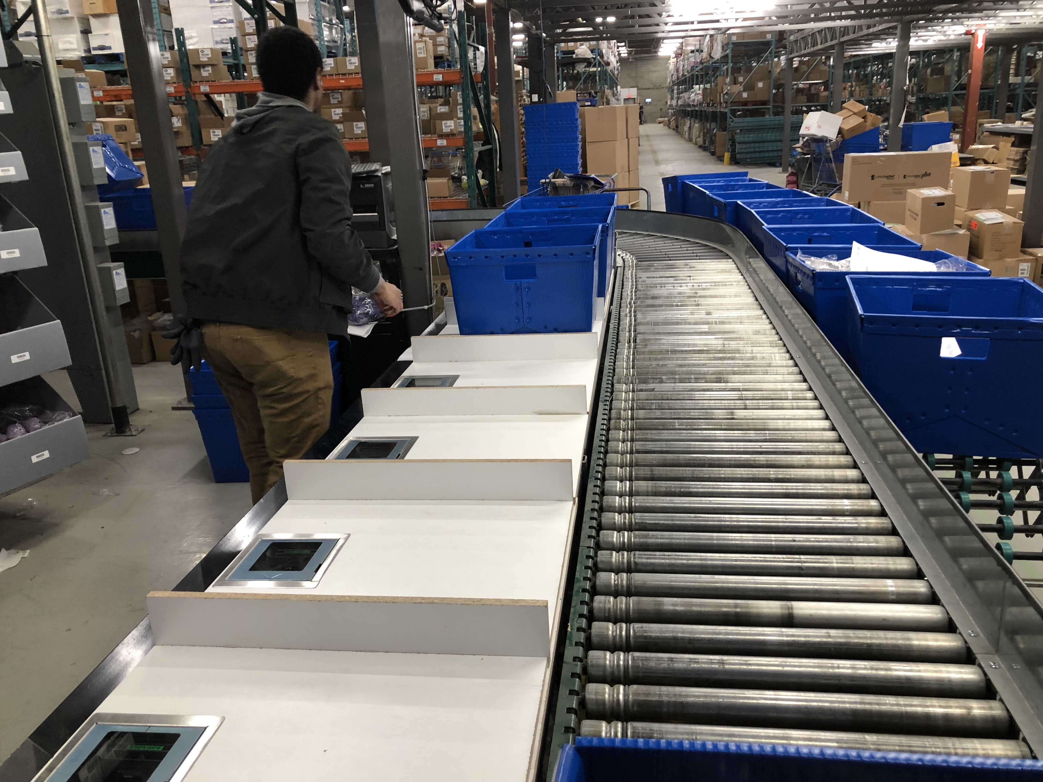
AS/R Horizontal Carousel
Medium Cost
High Speed
High Density

Slide 15
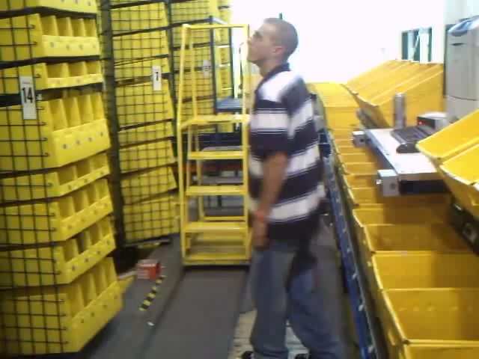
Horizontal Carousel

Slide 16
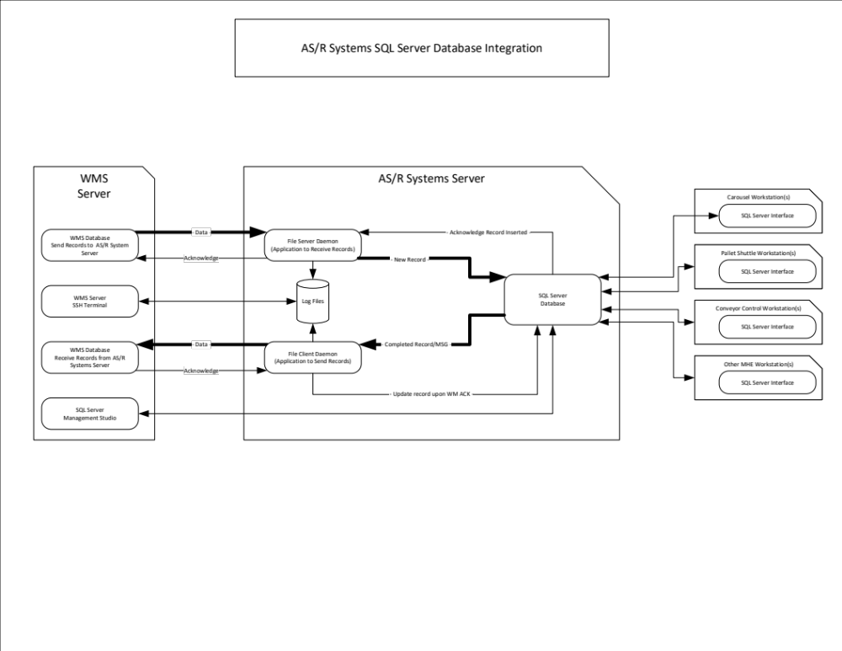

Slide 17
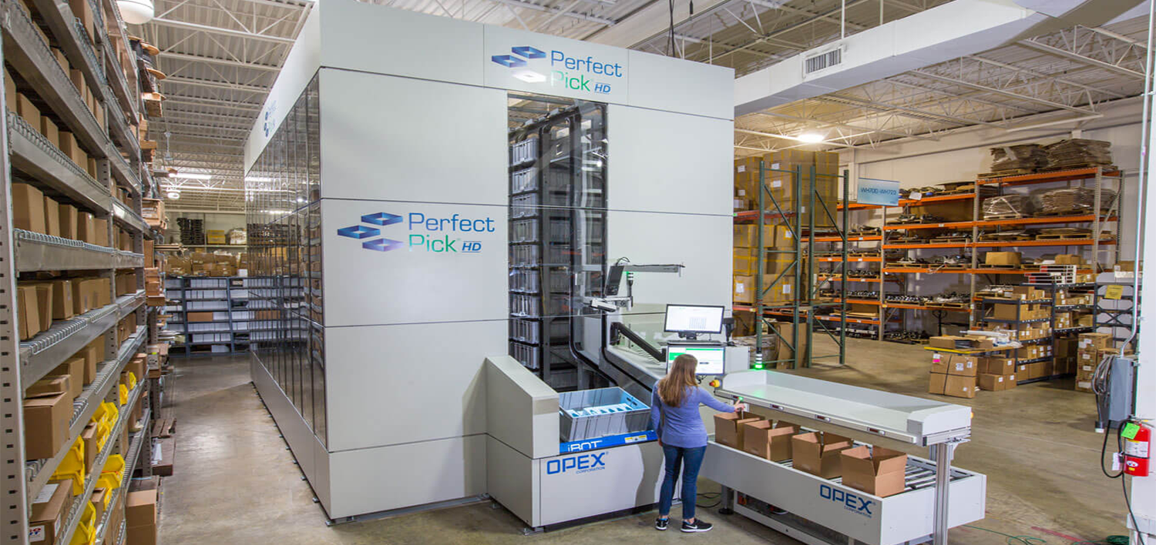
Small Item Shuttle (Opex)
8400 Locations
High Cost ($3,000,000)
High Speed
Medium Density

Slide 18
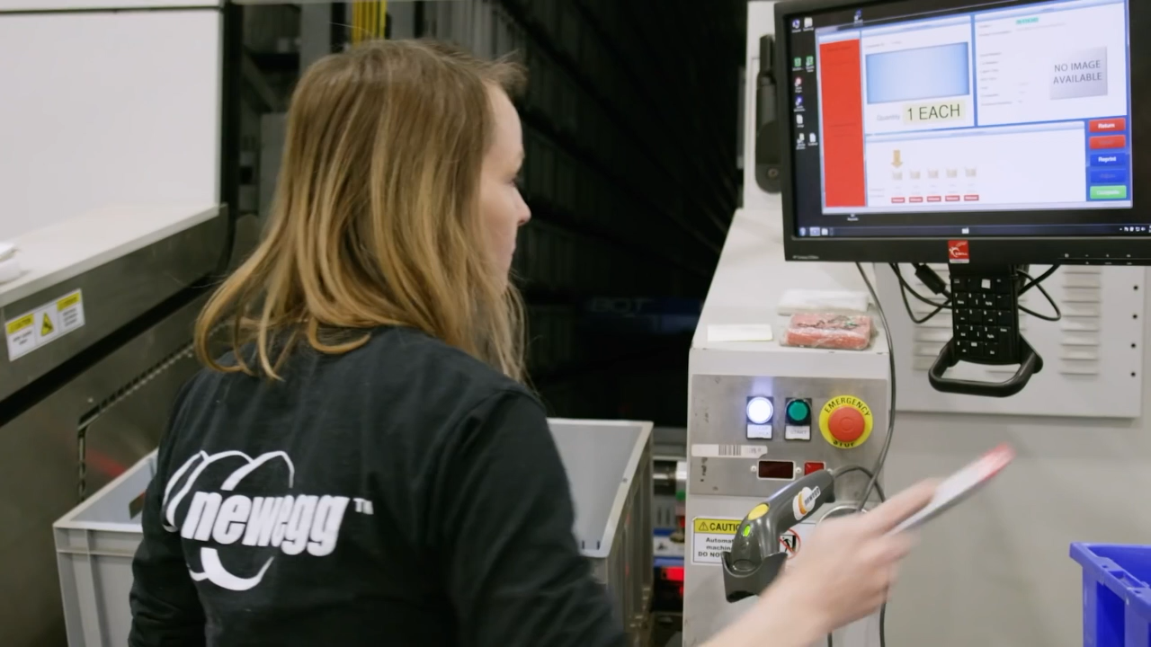
Small Item Shuttle (Opex)
8400 Locations
High Cost ($3,000,000)
High Speed
Medium Density

Slide 19
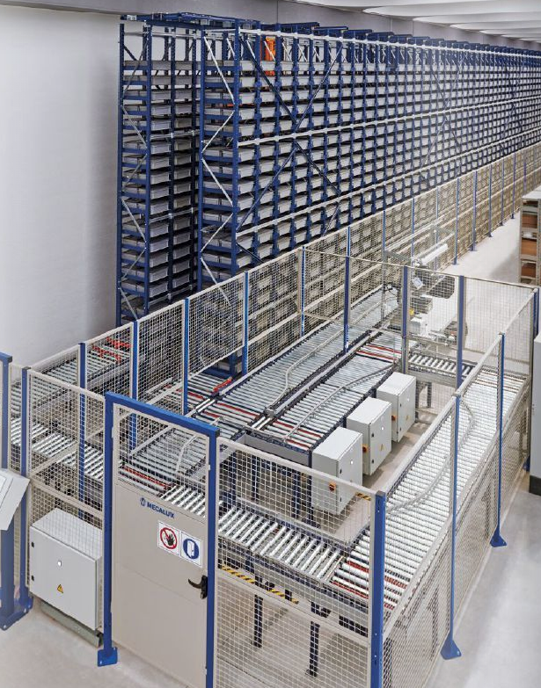
Mini-Stacker
Very Expensive
Medium Speed (Constrained by Lanes)
Medium Density

Slide 20
Solutions
Traditional
Low Cost
Low Speed
Low Density
Small Item Shuttles (Opex)
High Cost
High Speed
Medium Density
Order Pickers
Low to Medium Cost
Low Speed
Low Density
Mini-Stacker
High Cost
Medium Speed (Constrained by Lanes)
Medium Density
AS/R Horizontal Carousels
Medium Cost
High Speed
High Density
Vertical Carousels
High Cost
Low Speed
Medium Density

Slide 21
Solutions
More Efficient
• Opex
• Horizontal
Carousels
More Expensive
Less Expensive
• Vertical Carousels
• Stacker Crane
• Order
Pickers
Less Efficient
• Traditional
Storage

